Slide 1
Thank you for joining: Preventing Perinatal Hepatitis B and C Transmission
Subscribe to HepVu’s newsletter and blog updates at HepVu.org/email-signup
The webinar will begin at 11:00 am ET/ 8:00 am PT
Notes:
Ron
11:01 – Welcome! We’ll be getting started in a few minutes, we’re just giving folks time to filter in
11:02 – Welcome! We’ll give people a few more moments then we’ll get started
11:03 – Let’s get started.

Slide 2
Preventing Perinatal Hepatitis B and C Transmission
Ronald O. Valdiserri, MD, MPH
Co-Chair of HepVu
Professor, Department of Epidemiology,
Rollins School of Public Health,
Emory University
Notes:
Ron
11:03 – Thank you all for joining me today. My name is Dr. Ronald Valdiserri, and I am co-chair of HepVu. I am also a professor in the department of epidemiology at Emory University’s Rollins School of Public Health.
Today we’ll discuss perinatal Hepatitis B and C transmission in the U.S.
During the webinar, I will give a brief introduction of HepVu and set the stage for our experts, who will review
The current state of Hepatitis B and C among pregnant women and women of childbearing age
Underlying factors that contribute to perinatal hepatitis transmission
Strategies for prevention, including screening recommendations
As a quick note, we are recording this webinar and will be sharing it in the coming days
We know many of our colleagues are still engaged in the COVID-19 response, so we are making it available for them, and in case any of you would like to share with your teams
We at HepVu thank them for their work to address this pandemic.

Slide 3
Webinar Panelists
Speakers
Catherine A. Chappell, MD, MSc, Assistant Professor, Department of Obstetrics, Gynecology, and Reproductive Services, University of Pittsburgh
Julie E. Lazaroff, MPH, Unit Chief, Perinatal Hepatitis B Prevention Unit, Bureau of Immunization, New York City Department of Health and Mental Hygiene
Notes:
Ron
Joining me are:
Catherine A. Chappell, MD, MSc, Assistant Professor, Department of Obstetrics, Gynecology, and Reproductive Services, University of Pittsburgh
She will be discussing Hepatitis C as it relates to perinatal transmission
Julie E. Lazaroff, MPH, Unit Chief, Perinatal Hepatitis B Prevention Unit, Bureau of Immunization, New York City Department of Health and Mental Hygiene
She will be discussing Hepatitis B as it relates to perinatal transmission

Slide 4
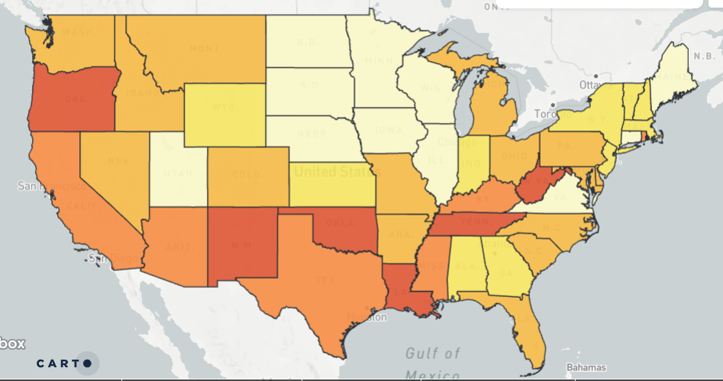
Making data on the viral hepatitis epidemic widely available, easily accessible, and locally relevant to inform public health decision making.
Mission
Estimated Rate of People Living with Hepatitis C, 2013-2016
Partnership between Gilead Sciences and Rollins School of Public Health at Emory University.
Notes:
Ron
With out further ado, I want to briefly introduce HepVu.org before turning this over to our speakers.
As many of you know, HepVu is an online platform that visualizes data and disseminates insights on the viral hepatitis epidemic across the United States.
As a Powered By AIDSVu project, HepVu uses existing AIDSVu infrastructure, led by my colleague Dr. Patrick Sullivan, to expand to other projects that visualize complex viral hepatitis information
HepVu is presented by Emory University’s Rollins School of Public Health in partnership with Gilead Sciences, Inc., and receives ongoing support and guidance from three groups consisting of key stakeholders and experts: the Advisory Committee, a Technical Advisory Group, and a Prevention and Treatment Advisory Committee.
HepVu is also advised by working groups convened on specific topics, including opioids
In short, here at HepVu we work to make data widely available, easily accessible, and locally relevant to inform public health decision-making

Slide 5
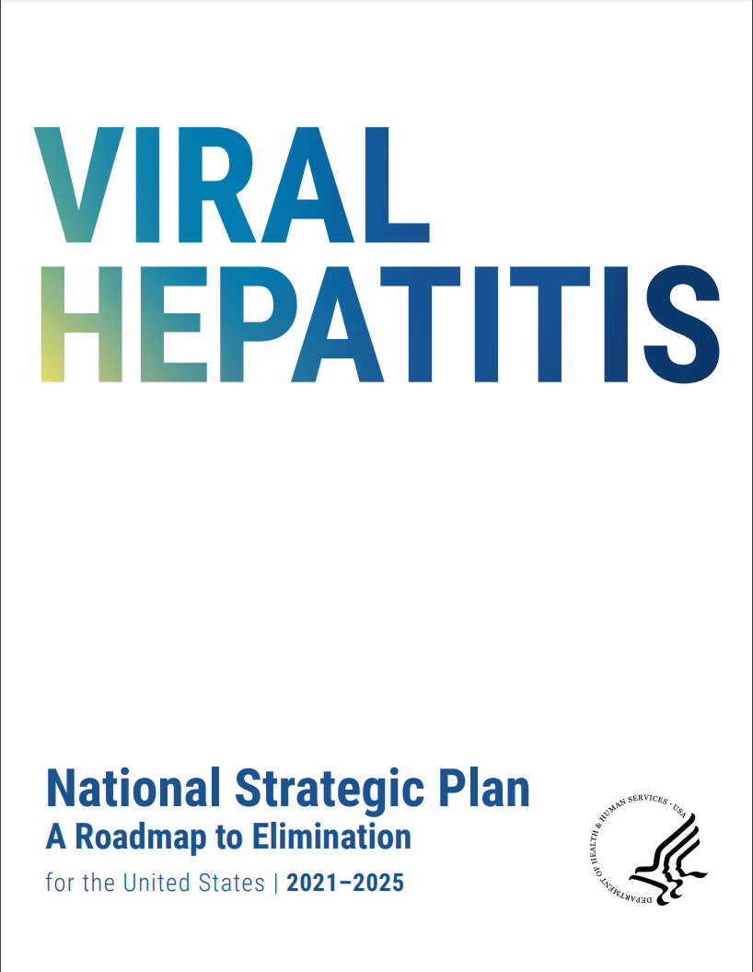
Why Perinatal?
Goal 1.3: “Eliminate perinatal transmission of Hepatitis B and Hepatitis C”
Notes:
Ron
In the spirit of this mission, we put together this webinar with our terrific speakers as reducing perinatal transmission of both B and C is vital to elimination, and as a result is an integral part of the U.S. Department of Health and Human Services’ (HHS) Viral Hepatitis National Strategic Plan: A Roadmap to Elimination 2021-2025 and CDC’s Division of Viral Hepatitis 2025 Strategic Plan

Slide 6
World Hepatitis Day July 28, 2021
World Hepatitis Day
Notes:
Ron
It’s also important to note that today is World Hepatitis Day.
This year’s theme is “Hepatitis can’t wait”, conveying the urgency of efforts needed to eliminate hepatitis as a public health threat by 2030.
At the end of the day, we cannot eliminate viral hepatitis without addressing perinatal Hepatitis B and C transmission.

Slide 7
Preventing Perinatal Hepatitis C Transmission Catherine A. Chappell, MD MSc Assistant Professor Department of Obstetrics, Gynecology and Reproductive Sciences
Catherine Chappell receives research funding from Gilead Sciences and Merck though Magee-Womens Research Institute (MWRI) and Catherine Chappell has served as a consultant for Gilead Sciences.

Slide 8
Objectives
Review prevalence of Hepatitis C among pregnant women and women of childbearing age, and associations with opioid epidemic
Review epidemiology of mother-to-child (MTC) Hepatitis C transmission
Describe current Hepatitis C screening recommendations for pregnant women
Identify strategies to prevent MTC transmission of Hepatitis C
Describe current status of the research regarding Hepatitis C treatment during pregnancy

Slide 9
Newly Reported Chronic Hepatitis C in the US, 2018
Number of newly reported* Hepatitis C cases by sex and age in the United States, 2018 (N=137,713)
* Data was not either not reportable by law statute or regulation, not reported or otherwise unavailable from Alabama, Arkansas, California, Delaware, District of Columbia, Hawaii, Indiana, Kentucky, Mississippi, Nevada, North Carolina Rhode Island, and Texas
https://www.cdc.gov/hepatitis/statistics/2018surveillance/HepC.

Slide 10
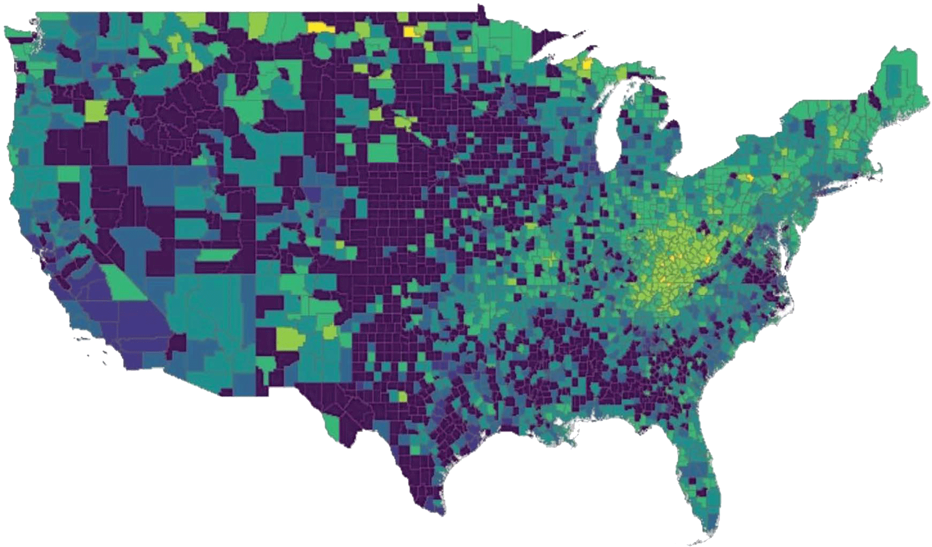
Defining the Scope of Maternal Hepatitis C
Maternal Hepatitis C Prevalence Per 1,000 Live Births: Per County, 2017
0.0−0.3
0.3−1.0
1.0−3.2
3.2−10.0
10.0−31.6
31.6−100.0
100.0−157.0

Slide 11
Maternal Characteristics Hepatitis C vs Non-Hepatitis C−Affected Pregnancies¹
Characteristic |  | HCV N=561,162 n (%) | Non-HCV N=515,203,728 n (%) | P
Race | Non-Hispanic white | 48,721 (79.7) | 7,927,310 (52.1) | <0.001
 | Non-Hispanic black | 2892 (4.7) | 2,161,667 (14.2)
 | Non-Hispanic Asian | 770 (1.3) | 958,060 (6.3)
 | Hispanic | 4976 (8.1) | 3,556,295 (23.5)
 | Other | 3803 (6.2) | 590,396 (3.9)
Social Factors | Married | 15,032 (24.7) | 8,838,815 (60.0) | <0.001
 | Less than 12th-grade education | 15,654 (26.0) | 2,130,022 (14.2) | <0.001
 | Medicaid | 47,320 (78.3) | 6,484,281 (42.9) | <0.001
Prenatal Factors | Parity | 1 (0–2) | 1 (0–2) | <0.001
 | Nulliparous | 15,747 (25.8) | 5,906,993 (38.9) | <0.001
 | History of prior cesarean birth | 12,153 (19.9) | 2,229,287 (15.1) | <0.001
 | History of preterm birth | 5180 (8.5) | 448,129 (3.0) | <0.001
 | Cigarette smoking | 36,929 (61.4) | 1,101,519 (7.3) | <0.001
 | No prenatal care | 3412 (5.9) | 228,556 (1.6) | <0.001
Maternal Hepatitis C Prevalence, by Race: 2009−2017¹
Hepatitis C Prevalence Per 1,000 Live Births
Hepatitis C infection is associated with increased risk of gestational diabetes, cholestasis of pregnancy, and preterm birth.

Slide 12
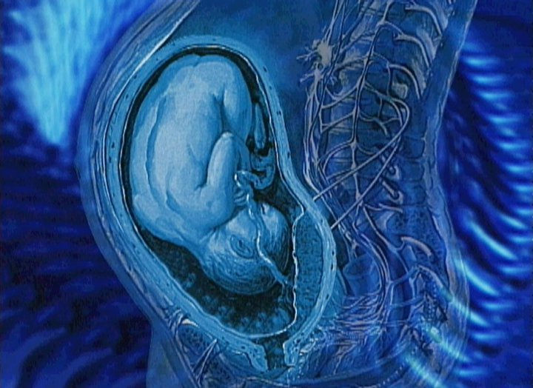
Perinatal Hepatitis C Transmission
What is the rate of perinatal Hepatitis C transmission?
5.8% (95% CI 4.2-7.80) (HIV negative)¹
10.8% (95% CI 7.6-15.2) (HIV co-infected)¹
Risk factors for mother-to child-transmission
Prolonged rupture of membranes²
Obstetric procedures and intrapartum events that lead to infant exposure to Hepatitis C-infected maternal blood; eg, internal fetal monitoring, vaginal/perineal lacerations²
Maternal injection-drug use³
Benova L., et al. CID. 2014; Tonsone G, et al. World J. Hepatol. 2014; Resti M, et al J Infect Dis. 2001

Slide 13
Universal Hepatitis C Screening During Pregnancy Now Recommended by Everyone
2018
2019
2020
May 2021
June 2021

Slide 14
Reasons Cited for Universal Hepatitis C Screening
Seeing increases in prevalence of Hepatitis C during pregnancy
Risk-based screening misses many Hepatitis C cases
Providers don’t ask, patients don’t tell
Risks identified; Hepatitis C test still not ordered
Pregnancy is a window of opportunity for Hepatitis C testing
Easy to implement – already universal screening for HIV and Hepatitis B
Identifying all Hepatitis C cases can improve outcomes
Mom: harm reduction counseling, linkage to Hepatitis C care/treatment
Baby: intrapartum transmission risk reduction, screening for perinatal transmission
Universal screening in pregnancy is cost-effective
Jhaveri R, et al CID 2018
Chaillon A, et al CID 2019

Slide 15
Assessment of Mother-to-Child Hepatitis C Transmission
Birth
2−6 Months
18 Months
3 Years
Earliest time for testing with HCV-RNA NAAT
Recommended testing with HCV Ab to establish MTCT
Confirmatory HCV-RNA testing recommended for those who are HCV Ab-positive at 18 mo
Earliest time point for Hepatitis C treatment initiation
Unfortunately, screening for perinatal Hepatitis C transmission is only done 11-30% of the time.
Chappell CA, et al. Pediatrics 2018; Lopata SM, et al, Pediatrics, 2020;
Kuncio DE, et al. Clin Infect Dis. 2003; Delgado-Borrego A. J Pediatr, 2012

Slide 16
Interventions to Decrease Perinatal Transmission: Lessons from HIV?
Elective cesarean delivery?
No randomized controlled trials
Meta-analysis of 8 studies including 641 mother-infant pairs show no change in transmission rate (Gharmar ME, et al. Arch Gynecol Obstet. 2011)
Avoidance of breast feeding?
No Hepatitis C RNA found in breastmilk (Polyweka S, et al. Clin Infect Dis. 1999)
No increased transmission with breast vs. bottle feeding (Kumar RM, et al. J Hepatol. 1998)
Avoidance of invasive procedures
Fetal scalp monitoring, amniocentesis, operative delivery

Slide 17
Hepatitis C Treatment During Pregnancy?
Arguments in Favor of Treatment
Treatment of Hepatitis C during pregnancy would reduce postpartum loss to follow-up by treating women at a time when they are engaged in prenatal care under insurance coverage
Possible decrease in MTCT
Children infected with Hepatitis C through MTCT develop cirrhosis at an earlier age than children who acquired infection through other routes during childhood, and are also at risk of acquiring hepatocellular carcinoma
Surveys indicate the majority of women with Hepatitis C would be interested in Hepatitis C treatment during pregnancy if it could decrease MTCT
Arguments Against Treatment
Currently, there are few data on
Safety of Hepatitis C treatment in pregnancy
Safety of treatment in breastfeeding women

Slide 18
First Study of Ledipasvir/Sofosbuvir in Pregnant Women
Recruitment: October 2016 to October 2018
Enrollment criteria
Hepatitis C-positive; 18‒39 years of age
Enrollment at 23 to 24 weeks gestation
Singleton gestation without fetal anomalies
Non-genotype 2 or 3
No Hepatitis B, cirrhosis, or clinically significant drug use
Not at high-risk of spontaneous preterm birth
29 patients screened
Screen fails (n=20)
Genotype 2: 5 patients
Genotype 3: 5 patients
Ongoing drug use: 4
Declined participation: 3
Delivering at outside hospital: 2
Concern for cirrhosis: 1
9 enrolled
9 completed study medication and delivered
9 infants enrolled
9 completed SVR assessment
9 infants completed 1-year follow-up
*Note: Use of Ledipasvir/Sofosbuvir during pregnancy is not recommended, except in a research trial

Slide 19
Conclusions from the Study
In this first study of Ledipasvir/Sofosbuvir administration during pregnancy, there were no clinically significant changes in Sofosbuvir or Ledipasvir levels identified attributable to pregnancy.
Ledipasvir/Sofosbuvir treatment started between 23-24 weeks of gestation was safe and effective, resulting in a 100% cure rate without any significant safety outcomes (N=9).
Further studies should consider evaluation of pan-genotypic regimen for pregnancy (actively recruiting!)
Larger studies must be conducted to confirm the safety and efficacy of Hepatitis C treatment during pregnancy.
Chappell CA, Lancet Microbe, 2020
Notes:
In this first study of HCV treatment during pregnancy, LDV/SOF was safe for pregnant women and effective for HCV cure. Specifically 100% of participants to date have been cured of HCV and all infants are HCV negative to date. Although many participants experiences adverse events, all were mild and thus LDV/SOF is well tolerated among pregnant women.
Given our significant rate of screen failure to due genotype 2 and 3 infection, a future study of a pan-genotypic regimen that can cover those genotypes is desperately needed.
And given that this is just a pilot study, a larger study must be conductive to confirm the safety and efficacy of HCV treatment during pregnancy before this strategy can be recommended widely.

Slide 20
Hepatitis C treatment in pregnancy: increased self-esteem and sense of well-being, which was sometimes protective against relapse
I’m down to like barely detectable... I think it’s definitely gonna help me not wanna keep relapsing or using because this has been such a process trying to cure it... that’s not the life I wanna live anymore, I don’t wanna use
“...Life-saving...”
I think I’m.. a bright thing and it’s a clean start...
I mean ecstatic, grateful. I don't know, kind of proud that I went through with something and accomplished it.
Kislovsky Y, et al. Under Review at Substance Abuse

Slide 21
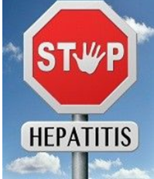
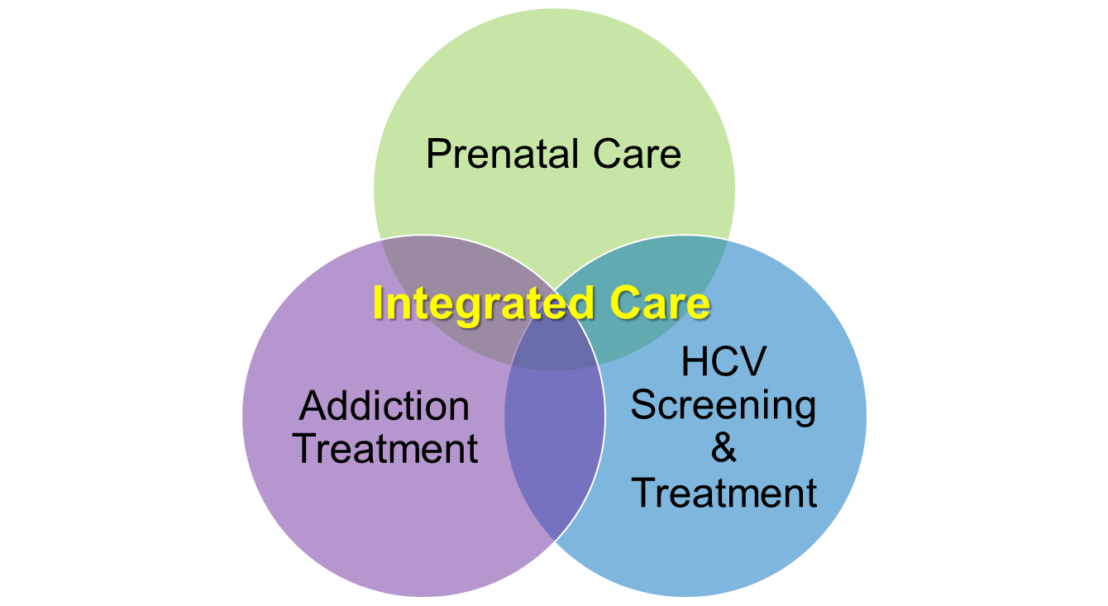
Goal = Hepatitis C Elimination
Substance use
Mental Heath Disorders
Poverty
Incarceration
Trauma
Poor social support
Test and Treat During
Prenatal care

Slide 22
Preventing Perinatal Hepatitis B Transmission
HepVu Webinar, July 28, 2021
Julie Lazaroff, MPH
New York City Department of Health and Mental Hygiene,
Bureau of Immunization
Notes:
This presentation is intended as an Introduction to Perinatal Hepatitis B Prevention and Surveillance, and I will be able to go into more detail if there are questions at the end.

Slide 23
Conflict of Interest Disclosure
Presenter: Julie Lazaroff, MPH
I do not have any conflicts of interest to disclose.

Slide 24
Learning Objectives
After this presentation, participants will be able to understand:
Hepatitis B serology, transmission
Perinatal and chronic Hepatitis B infection
Hepatitis B epidemiology
Perinatal Hepatitis B prevention methods
Public health approaches

Slide 25
Hepatitis B Serology
Test Name | Abbreviation | Marker for
Hepatitis B surface antigen | HBsAg | acute or chronic infection
Hepatitis B surface antibody | Anti-HBs | immune response after infection or vaccination (>=10 mIU/mL)
Hepatitis B e antigen | HBeAg | presence of viral replication and infectivity
Hepatitis B virus DNA | HBV DNA | viral load: presence and level of viral replication
Notes:
First, let’s review common serology indicators for hepatitis B
HBsAg - indicator of acute or chronic infection
Anti-HBs – indicator of an immune response after infection or vaccination (>=10 mIU/mL)
HBeAg - presence of viral replication and infectivity
HBV DNA viral load: presence and level of viral replication – may be + with a negative HBsAg – occult infection – treat as if HBsAg +

Slide 26
Hepatitis B Transmission
Spreads when blood, semen, or other body fluid infected with Hepatitis B enters the body of someone who is not infected or immune
Birth to an infected mother
Sexual contact
Injection drug use
Sharing items like toothbrushes, razors, or other sharp instruments
Not spread by food, water, sharing utensils, kissing, coughing, sneezing or breastfeeding
Virus remains infectious on surfaces up to 7 days
Notes:
Spreads when blood, semen, or other body fluid infected with Hepatitis B enters the body of someone who is not infected
Birth to an infected mother
Sexual contact
Injection drug use
Sharing items like toothbrushes, razors, or other sharp instruments
Not spread by food, water, sharing utensils, kissing, coughing, sneezing or breastfeeding
The virus is highly transmissible by parenteral route; and is also transmitted through mucosal or nonintact skin exposure

Slide 27
Perinatal Hepatitis B Infection
Hepatitis B infection acquired from a Hepatitis B infected mother in a child <24 months of age
Usually occurs during delivery
Testing is required to diagnose
Risk of infection depends on the HBeAg and HBV DNA status of the mother¹
~90% (mother is HBeAg-positive)
5%–20% (mother is HBeAg-negative)
High levels of HBV DNA ( > 200,000 IU/ml)
90% of newborns who become infected develop life-long (chronic) Hepatitis B infection
Only 5% of adults develop chronic infection
1. Nelson NP, Jamieson DJ, Murphy TV. Prevention of Perinatal Hepatitis B Virus Transmission. J Pediatric Infect Dis Soc. 2014;3 Suppl 1(Suppl 1):S7-S12. doi:10.1093/jpids/piu064
Notes:
Hepatitis B infection acquired from a hepatitis B infected mother in a child less 24 months of age
Mother to child transmission (MTC) usually occurs during delivery (though rare cases can occur in-utero)
Perinatal hepatitis B infection in a child aged ≤24 months is usually asymptomatic, so a diagnosis relies on testing; a positive HBsAg test, HBeAg test, or hepatitis B DNA test is considered laboratory evidence of perinatal hepatitis B in an infant born to an HBV-infected mother
The risk of perinatal hepatitis B infection for infants born to HBsAg-positive mothers who do not receive the recommended intervention is associated with the HBeAg and HBV DNA status of the mother ---the risk is approximately 90% if mother is HBeAg-positive) and 5%–20% ifthe mother is HBeAg-negative) and mothers who have very high levels of HBV DNA ( > 200,000 IU/ml)
90% of newborns who become infected develop life-long (chronic) infection compared to only 5% of adults who become infected
Up to 90% of perinatal infections become chronic [5–12] compared with approximately 5% of adult infections [9, 13].
Approximately 90% of infants of HBsAg-positive, HBeAg-positive women and 5%–20% of infants of HBsAg-positive, HBeAg-negative women become infected without intervention [6, 7, 10, 15, 16, 22–27]. The most important risk factor for MTCT is the maternal HBV DNA level [8, 15, 16, 28, 29]. Most MTCT infant PEP failures occur at thresholds of maternal HBV DNA levels of ≥10⁶ to ≥10⁸ copies/mL [10, 15, 30–32]. When HBV is acquired during pregnancy, third-trimester infections carry the highest risk for MTCT [21]. MTCT can occur during pregnancy or intrapartum [8, 15, 33, 34].

Slide 28
Chronic Hepatitis B Infection
Inability to clear Hepatitis B resulting in chronic Hepatitis B
Defined by Hepatitis B surface antigen (HBsAg) positive > 6 months
Most people have no symptoms but can still spread Hepatitis B
25% of people who develop chronic Hepatitis B infection during childhood will die from serious liver disease, like cirrhosis (scarring of liver) and liver cancer (hepatocellular carcinoma)
Treatment to achieve undetectable levels of virus
Hepatitis B viral DNA integrates into host DNA for life
Suppressive treatment is available
Halts viral transmission and disease progression
Reactivation is still possible
Notes:
Inability to clear Hepatitis B resulting in chronic Hepatitis B
Defined by Hepatitis B surface antigen (HBsAg) positive > 6 months
Most people have no symptoms but can still spread Hepatitis B
25% of people who develop chronic Hepatitis B infection during childhood will die from serious liver disease, like cirrhosis (scarring of liver) and liver cancer (hepatocellular carcinoma)
Though no cure for hepatitis B is available, with treatment, the viral levels can be significantly reduced
The reason that a cure has not been found for hepaititis B is it is a DNA virus which integrates into host DNA for life, whereas Hepatitis C is an RNA virus
There are currently effective suppressive treatments available that can halt viral transmission and liver disease progression (HBsAg clearance is the goal of treatment).
However it is still possible to have reactivation of viral replication if the patient becomes immunosuppressed for example due to chemotherapy.

Slide 29
Hepatitis B Epidemiology

Slide 30
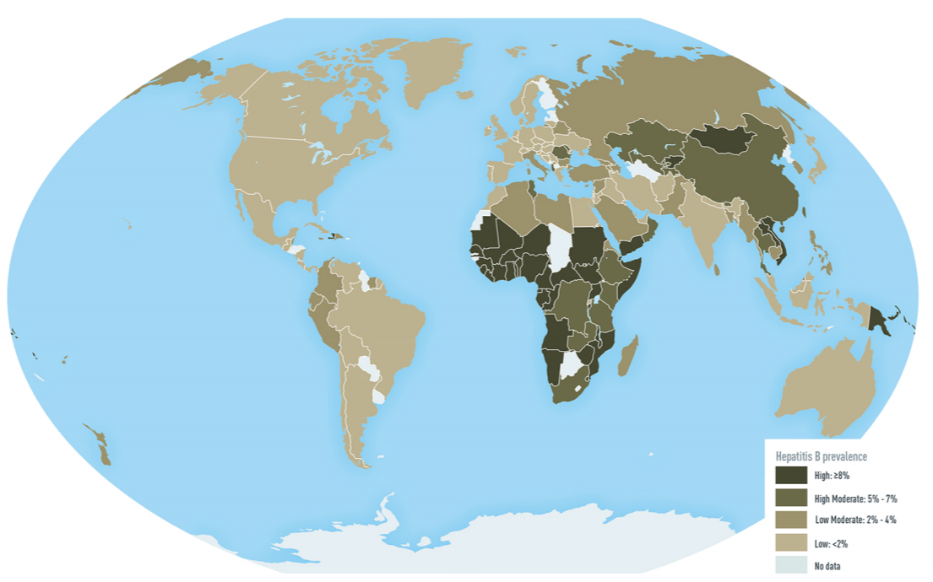
Epidemiology – Worldwide Chronic Hepatitis B Prevalence
292 million people living with chronic Hepatitis B¹
>880,000 deaths/year
Perinatal transmission accounts for 50% of global chronic Hepatitis B burden
Geographic distribution described in terms of prevalence (low to high)
Dark to Light shading (High to Low)
High: ≥8%; High moderate: 5-7%; Low moderate: 2-4%; Low: <2%
1.Polaris Observatory Collaborators. Global prevalence, treatment, and prevention of hepatitis B virus infection in 2016: a modelling study. Lancet Gastroenterol Hepatol. 2018 Jun;3(6):383-403. doi: 10.1016/S2468-1253(18)30056-6. Epub 2018 Mar 27. PMID: 29599078.; 2. Image source: Schweitzer et al, 2015
Notes:
292 million people living with chronic Hepatitis B, almost 4% of the world’s population with more than 880,000 deaths/year due to cirrhosis and liver cancer
80% lives in an intermediate or high-prevalence area
Perinatal transmission accounts for 50% of global chronic Hepatitis B burden
Worldwide geographic distribution of chronic infection is shown on the world map and shading represents prevalence rates measured from high to low, where high or >=8% prevalence is represented by the darkest shading in the regions of sub-Saharan Africa and parts of Asia, notably in China, whereas low or < 2% prevalence represented by the lightest shading.
in the areas of Western Europe, Australia, and most of the Americas, high moderate and low moderate regions ranging from 2-7% prevalence represented by the medium dark shading in the regions of the Middle East, Eastern Europe, and the Indian subcontinent.

Slide 31
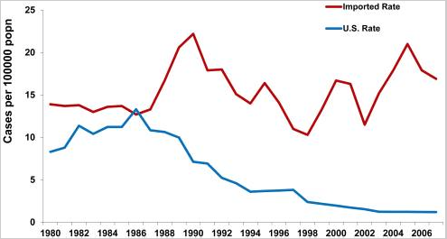
Epidemiology - United States Chronic Hepatitis B
850,000 – 2.2 million persons in the US have chronic Hepatitis B infection¹
~70% of persons with Hepatitis B in the US are foreign born
Declines in Hepatitis B infections correlate with the Hepatitis B vaccine licensure (1986) and the universal childhood Hepatitis B vaccination recommendation (1991)
Imported rate
U.S. rate
Hepatitis B vaccine licensed
Universal Infant Immunization,
US
Incidence of chronic Hepatitis B, U.S.-Acquired vs. Estimated Imported, United States, 1980-2008²
1. Nelson NR, Easterbrook PI, McMahon BJ, Epidemiology of Hepatitis B Virus Infection and Impact of Vaccination on Disease, Clinics in Liver Disease, Volume 20, Issue 4, 2016. 2. CDC, WHO, DHS
Notes:
In the United States, it is estimated that between 850,000to 2.2 million persons are living with chronic Hepatitis B infection , and of those, approximately 70% are foreign born
The chart on the right hand side of the slide shows the estimated number of chronic hepatitis B infections per 100,000 persons plotted over time on the horizontal axis from 1980 to 2006 .
Historical declines in hepatitis B infections correlated with the introduction of the hepatitis B vaccine in 1986 ADVANCE and the CDC
recommendation for routine HepB vaccination in children in 1991 ADVANCE
The chart on the right hand side of the slide shows the estimated number of cases of chronic hepatitis per 100,000, plotted on the vertical axis over time from 1980 to 2006 as plotted on the horizontal axis. The hepatitis B vaccine was licensed in1986 and vaccination of , Recombinant DNA vaccine was licensed
In 1991, the United States adopted a strategy for universal HepB vaccination of infants, resulting in a 75% decrease in the incidences of acute HBV across the country.
In the United States, rates of acute infection have remained about 1.0 per 100,000 population since 2009, and have been reported from more nonurban than urban regions.16 African American adults have the highest rate of acute HBV infection in the United States.15
Recently (2006–2013) an increase in incident cases of acute HBV infection in Kentucky, Tennessee, and West Virginia has occurred among non-Hispanic white people aged 30 to 39 years, who reported injection-drug use as a common risk factor.17

Slide 32
Hepatitis B Infected Patients of Childbearing Age United States
In the US, an estimated 20,071 infants were born to Hepatitis B infected pregnant patients in 2018¹
In NYC, the incidence of births to Hepatitis B infected pregnant patients per 100,000 live births decreased from 1,573 in 2006 to 1,329 in 2015 (APC = –1.4%; P = .02)²
In NYC, annual identification of Hepatitis B infected pregnant patients has continued to trend downward from 2015 to present
There was a 77% decline in the rate of new Hepatitis B chronic infections, among women of childbearing age, from 0.83% in 2011 to 0.19% in 2017 (P < .0001) based on national laboratory data (Quest Diagnostics)³
CDC – Expected Birth Tables (unpublished data)), 2021
Arciuolo RJ, Lazaroff JE, Rosen JB, Lim S, Zucker JR. Trends in Hepatitis B Surveillance Among Pregnant Women in New York City, 1998-2015. Public Health Reports. 2020;135(5):676-684. doi:10.1177/0033354920946793
3. Kushner T, Chen Z, Tressler S, Kaufman H, Feinberg J, Terrault NA. Trends in Hepatitis B Infection and Immunity Among Women of Childbearing Age in the United States. Clin Infect Dis. 2020;71(3):586-592. doi:10.1093/cid/ciz841
Notes:
A total of 37 755 women met the criteria for a diagnosis of chronic HBV from 2011 to 2017 (Table 2). Nationally, there was a 77% decline in the rate of new chronic infections, from 0.83% in 2011 to 0.19% in 2017 (P < .0001). A decrease over time was observed in all 3 vaccine-era cohorts (all P values < .0001; Figure 1B). Both sensitivity analyses with alternate definitions for chronic HBV infection demonstrated similar trends (Supplementary Tables 2 and 3). Significant increases in chronic HBV infections were only observed in Mississippi (0.20% to 0.39%), Kentucky (0.18% to 0.39%), and West Virginia (0.29% to 0.38%; all P values ≤ .05; Figure 2B; Supplementary Table 4).
Though in recent years, there CDC reported highest rates in FL, KY, ME, OH, TN, WV
Predominantly among whites, who reported injection drug use, age 30-39
Likely native-born adults who were not fully vaccinated during childhood

Slide 33
Race / Ethnicity of Hepatitis B Positive Mothers Who Delivered in 2020 (New York City, N=788)
Notes:
Asian/Pacific Islander, non-Latino 466 59.1 Black, non-Latino 169 21.5 White, non-Latino 69 8.8 Other 56 7.1 Latino/a 27 3.4 Unknown 1 0.1

Slide 34
Country of Birth for Hepatitis B Positive Mothers Who Delivered in 2020 (New York City, N=788)
Notes:
China 356 45.2 Other 208 26.4 U.S. 43 5.5 Uzbekistan 41 5.2 Guinea 27 3.4 Dominican Republic 21 2.7 Ghana 21 2.7 Bangladesh 19 2.4 Nigeria 18 2.3 Senegal 17 2.2 Haiti 13 1.7 Unknown 4 0.5

Slide 35
Perinatal Hepatitis B Prevention

Slide 36
Universal Hepatitis B Birth Dose Recommendation
Infants born to Hepatitis B negative mothers with birth weight > 2,000 grams and medically stable:
Administer a Hepatitis B vaccine within 24 hours of birth¹
New York State does not have a public health law requiring a universal Hepatitis B vaccine birth dose, but it is promoted as a best practice
Delivery facilities must adopt their own written policies
Vaccine information statements (VIS) are required to be given to the parents by law prior to vaccination of the infant
Families do not have to provide consent, but they must be informed and may decline
^{1.} S. Schillie, et. al., Prevention of Hepatitis B Virus Infection in the United States; MMWR; January 12,
2018;67(No.1). https://www.cdc.gov/mmwr/volumes/67/rr/rr6701a1.htm
Notes:
The most impactful strategy for reducing mother to newborn transmission of HBV is incorporating the birth dose into the hepatitis B vaccine schedule.
A birth dose followed by 2 more doses of hepatitis B vaccine can reduce the prevalence of chronic HBV in the infant by approximately 90% in infants of HBeAg-positive mothers and almost all HBeAg-negative mothers.
This birth dose is especially important in areas of the world where a significant proportion of HBsAg-positive mothers are also positive for HBeAg, such as in China, south east Asia, and the Pacific Islands. In these areas, if the birth dose is not given, the effectiveness of hepatitis B vaccine could be reduced to as low as only 50% to 75%.
In regions such as sub-Saharan Africa and Russia where less than 25% of HBsAg-positive pregnant women are also HBeAg positive, the impact of missing the birth dose is not as severe but is still significant. Including a dose of HBIG at birth to infants born to HBsAgpositive mothers can further reduce the risk of transmission to less than 5%. Beasley and his colleagues showed in a randomized-controlled trial, that with administration of the birth dose plus HBIG to infants born to HBsAg/HBeAg-positive mothers only 6% of those infants became HBsAg-positive verses 88% of infants who received placebo.25
Infants born to HBsAg negative mothers with birth weight > 2,000 grams and medically stable:
Administer a Hepatitis B vaccine within 24 hours of birth¹
Birthweight <2,000 grams or medically unstable:
Delay the Hepatitis B vaccine until hospital discharge or age one month
New York State does not have a public health law requiring a universal hepatitis B birth dose, but it is promoted as a best practice
Delivery must adopt their own written policies
Vaccine information statements (VIS) are required to be given to the parents by law prior to vaccination of the infant
Families do not have to provide consent, but they must be informed and they may decline

Slide 37
Vaccination for Infants Born to Hepatitis B Positive Mothers
Hepatitis B 1st dose vaccine and Hepatitis B immune globulin (HBIG) (within 12 hours of birth)
Hepatitis B 2nd dose vaccine at 1-2 months
Hepatitis B 3rd dose at 24 weeks at 6 months (168 days) – not earlier
Efficacy:
94% (both vaccine and immune globulin)
75% (vaccine alone)
71% (immune globulin alone)
Notes:
Though all newborns are recommended to receive the birth dose within 24 hours after birth, infants born to hepatitis B positive mothers must receive the HepB vaccine birth dose and the hepatitis B immune globulin or HBIG (within 12 hours of birth)
Administered at different injection sites (e.g., separate limbs)
HepB 2nd dose vaccine at 1-2 months
Combination vaccine can be given at > 6 wks of age
(Pediarix – 2, 4, 6)
> 3 doses of Hep B containing vaccine is permissible
HepB 3rd dose at 24 wks at 6 months (168 days) – not earlier
If birthweight <2000 grams, do not count HepB 1st dose as part of series
Give 3 additional doses with single-antigen vaccine at 1, 2-3, and 6 months or combination vaccine at 2, 4, and 6 months
Efficacy in preventing perinatal HBV transmission of thegiving both hepatitis B vaccine and the hepatitis immune globulin is 94%

Slide 38
Post-vaccination Testing for Infants Born to Hepatitis B Positive Mothers
Test infants for both HBsAg (infection) and Anti-HBs (immunity)
Test at 9 months of age (not earlier)
To avoid detection of passive anti-HBs from HBIG and maximize the likelihood of detecting late infection
Test 1-2 months after final dose
Testing <1 month after final dose may detect HBsAg from vaccine
Testing >2 months after final dose may not detect anti-HBs levels in protected persons; avoid unnecessary revaccination
Notes:
Test for both HBsAg (infection) and Anti-HBs (immunity)
Test at 9 months of age (not earlier)
Avoid detection of passive anti-HBs from HBIG
Maximize the likelihood of detecting late infection
Test 1-2 months after final dose
Testing <1 month after final dose
May detect HBsAg from vaccine
Testing >2 months after final dose
May not detect anti-HBs levels in protected persons
Avoid unnecessary revaccination

Slide 39
Hepatitis B DNA Testing and Antiviral Treatment
Recommendations from the AASLD, CDC, ACOG and the Society for Maternal and Fetal Medicine for Hepatitis B DNA testing and antiviral treatment for Hepatitis B infected pregnant patients are all aligned as follows:
Antiviral treatment for patients with HBV DNA levels > 200,000 IU/mL has been associated with significantly reduced rates of perinatal Hepatitis B transmission
All Hepatitis B infected pregnant patients should be tested for HBV DNA in each trimester
Patients with HBV DNA > 200,000 IU/mL not already being treated, should be considered for initiation of antiviral therapy at 28–32 weeks gestation
1. Norah A. Terrault, et al ,Update on Prevention, Diagnosis, and Treatment of Chronic Hepatitis B: AASLD (. American Academy of the Study of Liver Diseases ,) 2018 Hepatitis B Guidance, HEPATOLOGY, VOL. 67, NO. 4, 2018. https://www.aasld.org/sites/default/files/2019-06/HBVGuidance_Terrault_et_al-2018-Hepatology.pdf
2. Schillie S, Vellozzi C, Reingold A, et al. Prevention of Hepatitis B Virus Infection in the United States: Recommendations of the Advisory Committee on Immunization Practices. MMWR Recomm Rep 2018;67(No. RR-1):1–31. DOI: http://dx.doi.org/10.15585/mmwr.rr6701a1external icon.
Notes:
Recommendations for hepatitis B DNA testing and antiviral treatment from the AASLD, CDC, ACOG and the Society for Maternal and Fetal Medicine are all aligned as follows:
Antiviral treatment for hepatitis B-positive pregnant patients with HBV DNA levels > 200,000 IU/mL, as an adjunct to the post-exposure prophylaxis administered to the infant shortly after delivery, has been associated with significantly reduced rates of perinatal HBV transmission.
All hepatitis B-positive pregnant patients should be tested for HBV DNA in each trimester.
Patients with HBV DNA > 200,000 IU/mL not already being treated, should be considered for initiation of antiviral therapy at 28–32 weeks’ gestation

Slide 40
Public Health Approaches

Slide 41
National Perinatal Hepatitis B Prevention Program (PHBP), CDC
50 states, 6 cities including NYC and 6 US territories
National PHBP Program objectives:
Identify Hepatitis B infected pregnant and postpartum patients
For infants born to Hepatitis B infected mothers, ensure:
Newborn prophylaxis within 12 hours of birth (Hep B vaccine and HBIG)
Timely completion of the three-dose Hepatitis B vaccine series
Post vaccination testing
Notes:
CDC Perinatal Hepatitis B Prevention Program (PHBP) was established in 1990 and provides grant funding to Immunization Programs
The program objectives are to:
Identify Hep B+ pregnant women -
Provide education to mothers preferably during the prenatal period and post-partum
For infants born to HBV+ mothers, ensure:
Newborn prophylaxis within 12 hours of birth (Hep B vaccine and HBIG)
Timely completion of the three dose Hep B vaccine series
Post vaccination testing
Program staff conduct case management of infants to track, provider reminders to mothers and providers and obtain documentation of vaccinations and testing results

Slide 42
Hepatitis B Testing and Public Health Reporting during Pregnancy
All pregnant patients should be tested for HBsAg
All Hepatitis B infected pregnant patients should be tested for HBV DNA
All Hepatitis B infected pregnant patients should be reported to local public authorities in the jurisdiction where the patient resides
Reporters may include prenatal care providers, laboratories, delivery facilities, universal reporting methods
Reporting methods may include paper or electronic methods
Notes:
All HBsAg+ pregnant patients should be tested for HBV DNA several times during pregnancy to determine if anti-viral therapy is required for patient’s disease and/or to help prevent MTC transmission
Maternal antiviral therapy started at 28–32 weeks gestation has been associated with significantly reduced rates of perinatal HBV transmission (CDC, MMWR, 2018)
The AASLD suggests antiviral therapy to reduce the risk of perinatal transmission of Hepatitis B in HBsAg-positive pregnant women with an HBV DNA level > 200,000 IU/mL
Universal reporting methods i.e., birth certificates and newborn metabolic screening requisition forms

Slide 43
Identification of Hepatitis B Infected Pregnant Patients New York City
NYS Public Health Law mandates provider initiated prenatal testing and reporting
NYC health code requires laboratories to report pregnancy status (since 2014)
Prenatal panels that include Hepatitis B testing, pregnancy related ICD-10 codes, pregnancy questions on lab requisitions, patients admitted to L&D
Maternal HBsAg status is recorded on the Newborn Metabolic Screening Form for all newborns
Enhanced surveillance methods using additional data sources such as birth certificate data and newborn metabolic screening data
Referral to patient navigation for Hepatitis B evaluation
Notes:
NYS Public Health Law mandates prenatal testing, provider reporting, and laboratory reporting for both Hep B and Syphilis
In July 2014, the NYC health code was amended to require laboratories to report pregnancy status (confirmed or probable)
Provider reporting is not reliable
Laboratory has potential to be more reliable

Slide 44
Summary
Hepatitis B continues to be a significant public health problem worldwide
Chronic infection associated with lifelong morbidity and mortality
US incidence of Hepatitis B has declined dramatically but prevention of perinatal Hepatitis B infection remains critical
Majority of Hepatitis B positive pregnant patients are foreign-born
The combined approach is very effective in preventing most infections
Local public health should provide conduct case management to ensure vaccination and testing of the infants
Multiple surveillance strategies should be used to identify Hepatitis B in pregnancy
Notes:
Hepatitis B continues to be a significant public health problem worldwide
Chronic infection associated with lifelong morbidity and mortality
US incidence of Hepatitis B has declined dramatically but prevention of perinatal Hepatitis B infection remains critical
Majority of Hepatitis B positive pregnant patients are foreign-born
The combined prevention approach of universal Hepatitis B testing of pregnant women, universal Hepatitis B birth dose, vaccination and testing of infants born to Hepatitis B infected mothers and anti-viral treatment of pregnant patients when indicated, is a very effective combined approach in preventing most infections
Multiple surveillance strategies, including laboratory and provider reporting to local public health as well as a universal reporting method in each jurisdiction, should be used to identify Hepatitis B in pregnancy. Local public health should provide conduct case management to ensure vaccination and testing of the infants.

Slide 45
Thank you for joining: Preventing Perinatal Hepatitis B and C Transmission
Subscribe to HepVu’s newsletter and blog updates at HepVu.org/email-signup
The recording and slides will be available on HepVu.org
Notes:
Ron

